Slide 1
Quiz: what happens when a photon hits an atom?
For example an H atom with one electron in the s-shell
A) At some point in time the photon gets absorbed, the photon disappears and the electron in the s-shell is excited to the p-shell
B) Photons are electromagnetic waves. The electron starts to oscillate around the nucleus with the photon frequency
C) Electrons are particles. The photon bounces like a ball of the electron, thereby transferring part of its energy to the electron
Notes:
I know that the 1s to 2p excitation of H is not in the x-ray range ( ¾ Rydberg, 10.2 eV) but all our theories are conveniently rather independent from the actual energy scale. (Linear response does not depend on the value of omega) For the purist replace H by Fe25+ (also a single electron around a nucleus, but as Z=26 in this case the excitation energy is 26^2 * ¾ = 507 Rydberg or 6898 eV)

Slide 2
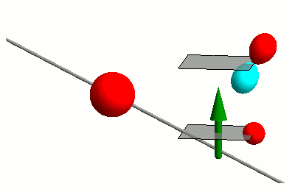
Interaction of photons with matter
RIXS
nIXS

Slide 3

Interaction of photons with matter
RIXS
nIXS

Slide 4
Time dependent perturbation theory
Fermi’s golden rule

Slide 5
Time dependent perturbation theory
Fermi’s golden rule
Green’s function – spectral representation (energy domain)

Slide 6
Time dependent perturbation theory
Fermi’s golden rule
Green’s function – spectral representation (energy domain)
Green’s function – (time domain)

