Slide 1
Spectroscopy
Excitons, resonances and band transitions
Maurits W. Haverkort
Institute for theoretical physics – Heidelberg University
M.W.Haverkort@thphys.uni-heidelberg.de

Slide 2
Three classes of excitations
Band excitations
Resonances
Excitons

Slide 3
X-ray absorption spectroscopy – excitons
W=1
U=20
Q=0
Core – valence interaction
Intensity
2p
Energy (eV)

Slide 4
X-ray absorption spectroscopy – excitons
W=1
U=20
Q=0.25
Intensity
2p
Energy (eV)

Slide 5
X-ray absorption spectroscopy – excitons
W=1
U=20
Q=0.5
Intensity
2p
Energy (eV)

Slide 6
X-ray absorption spectroscopy – excitons
W=1
U=20
Q=1.0
Intensity
2p
Energy (eV)

Slide 7
X-ray absorption spectroscopy – excitons
W=1
U=20
Q=1.25
Intensity
2p
Energy (eV)

Slide 8
X-ray absorption spectroscopy – excitons
W=1
U=20
Q=1.5
Intensity
2p
Energy (eV)

Slide 9
X-ray absorption spectroscopy – excitons
W=1
U=20
Q=1.75
Intensity
2p
Energy (eV)

Slide 10
X-ray absorption spectroscopy – excitons
W=1
U=20
Q=2.0
Exciton
Intensity
Continuum edge jump
2p
Energy (eV)

Slide 11
Three classes of excitations
Band excitations
Resonances
Excitons

Slide 12
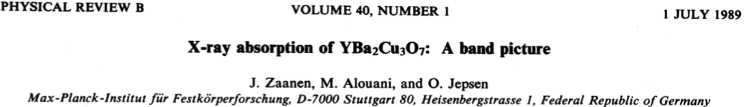
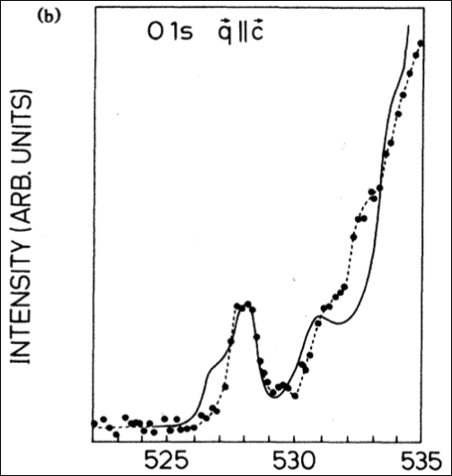
X-ray absorption spectroscopy – a band picture
1s

Slide 13
Three classes of excitations
Band excitations
Resonances
Excitons

Slide 14
X-ray absorption spectroscopy – excitons
2p

Slide 15
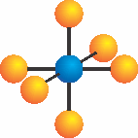


X-ray absorption spectroscopy – excitons
2p

Slide 16
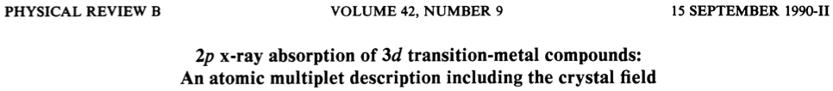
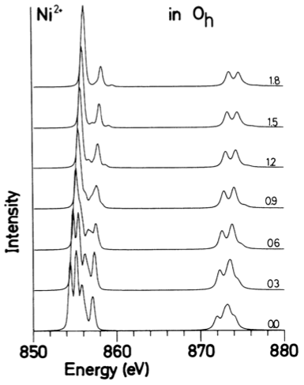
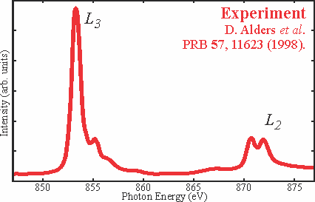
Local many body calculations based on parameters

Slide 17
Local many body calculations based on parameters
Parameters
Size of the Coulomb interaction
Size of the crystal-field

Slide 18
How to calculate these parameters
Theory
Experiment
Start from LDA potential
Create Wannier functions
On this basis and potential build local Hamiltonian including all local many body interactions
Solve by exact diagonalization
Phys. Rev. B 85, 165113 (2012)
2p
M.W. Haverkort, M. Zwierzycki, O.K. Andersen, PRB 85, 165113 (2012).

Slide 19
What do you need to consider when calculating excitons
Example of d-d excitations in NiO

Slide 20
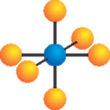
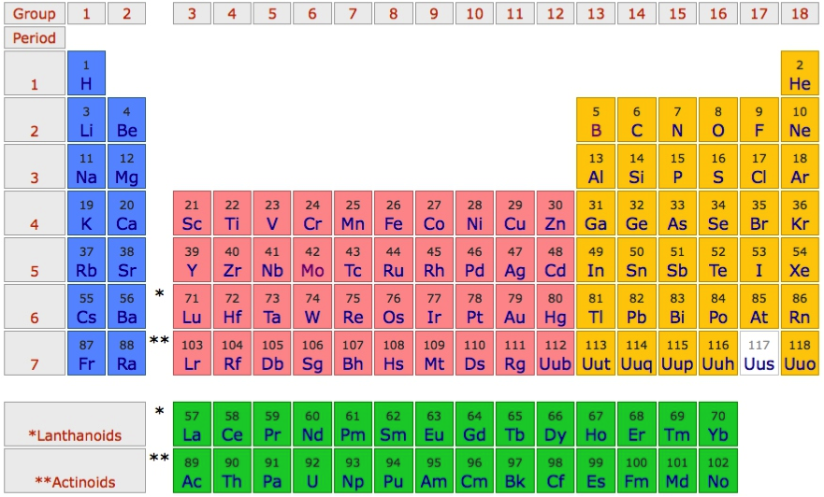
Example of localized states in NiO - excitons
O²⁻ - 2p⁶
Ni²⁺ - 4s⁰ 3d⁸

Slide 21
Partly filled degenerate d-shell – in LDA NiO is a metal

Slide 22
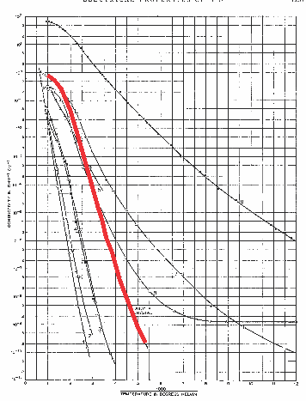
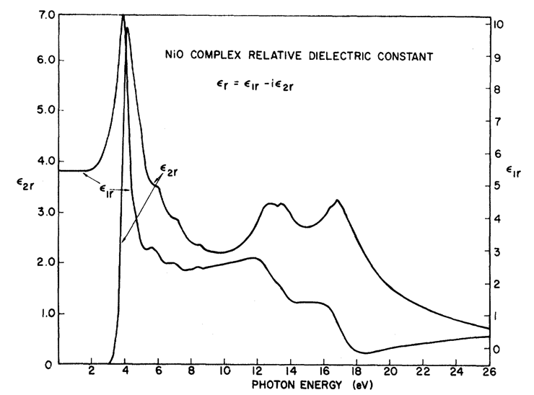
In LDA NiO is a metal: Experimentally it is a good insulator
F. J. Morin, Phys. Rev. 93, 1199 (1954)
Local d-d excitations inside the optical gap. Week in optics as NiO has inversion symmetry, i.e. they are dipole forbidden
R. Newman and R. M. Chrenko,
Phys. Rev 114 1507 (1959)
Room temperature
ρ~10⁵ Ω cm
Conductivity (Ω⁻¹ cm⁻¹)
Optical-gap
3.5 – 4.0 eV
Temperature⁻¹

Slide 23
d-d excitations inside gap (inelastic x-ray scattering)
Beyond – dipole
1 eV loss of
10 000 eV photons
Theory M. W. Haverkort et al. PRL 99, 257401 (2007)

Slide 24
Orbital energy level diagram
e_{g}
t_{2g}

Slide 25
First peak, excitation from t_{2g} to e_{g}
First peak, understandable on the level of LDA+U
M. W. Haverkort et al. PRB 85, 165113 (2012)

Slide 26
Third peak – Coulomb repulsion
Coulomb repulsion is smaller when electrons are farther apart
d_{z2}
d_{x2-y2}
d_{xy}

Slide 27
Third peak – Coulomb repulsion
Coulomb repulsion is smaller when electrons are farther apart
d_{z2}
d_{x2-y2}
d_{xy}
d_{xy}

Slide 28
Third peak – Coulomb repulsion
Third peak understandable on the level of time dependent LDA+U
M. W. Haverkort et al. PRB 85, 165113 (2012)

Slide 29
Second peak, double excitation from t_{2g} to e_{g}
DMFT with ED solver
Mix of DMRG and Quantum Chemistry
M. W. Haverkort et al. PRB 85, 165113 (2012)

Slide 30
Second peak, double excitation from t_{2g} to e_{g}
Warning!!! A single photon can only excite a single electron. The reason you see these strong double excitations is a true quantum many-body effect!
- Need to solve locally the full many-body problem
M. W. Haverkort et al. PRB 85, 165113 (2012)

Slide 31
Multi-electron excitations – more rule than the exception
Mn role in photosynthesis

Slide 32
Three classes of excitations
Band excitations
Resonances
Excitons

Slide 33
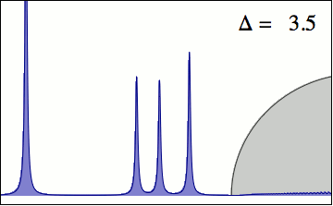
Interaction between localized and delocalized states
Elastic line
Local excitons
(d-d excitations)
Itinerant excitations
(charge-transfer)
M. W. Haverkort et al. EPL 108, 57004 (2014)

Slide 34

Interaction between localized and delocalized states
Elastic line
Local excitons
(d-d excitations)
Itinerant excitations
(charge-transfer)
M. W. Haverkort et al. EPL 108, 57004 (2014)

Slide 35
Interaction between localized and delocalized states (MnO)
LDA+Ligand – Field
LDA+DMFT

Slide 36
Intro many-body

